Slide 1
Knowledge Gradient Bid Policies for Online Advertisement Auctions
Prachi Joshi

Slide 2
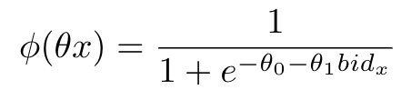
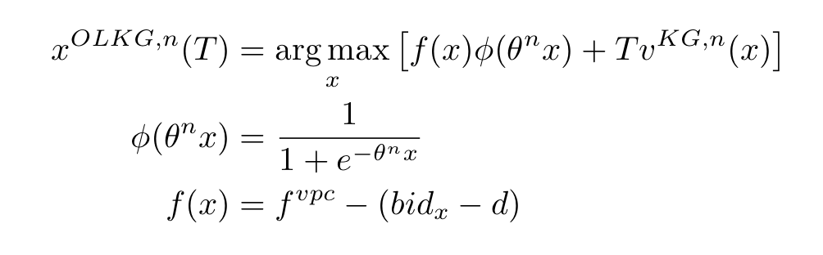
Modelling the Problem Setting
Role of the policy: optimize the bids you place in online auctions to maximize the profits you make off of the advertisements
A difference between immediate profits and long term profits, which is where the knowledge gradient comes in
Modelled probability of winning an auction and getting a click as a logistic function:
Modelled the expected profit given a click as a linear function of the bid placed:

Slide 3
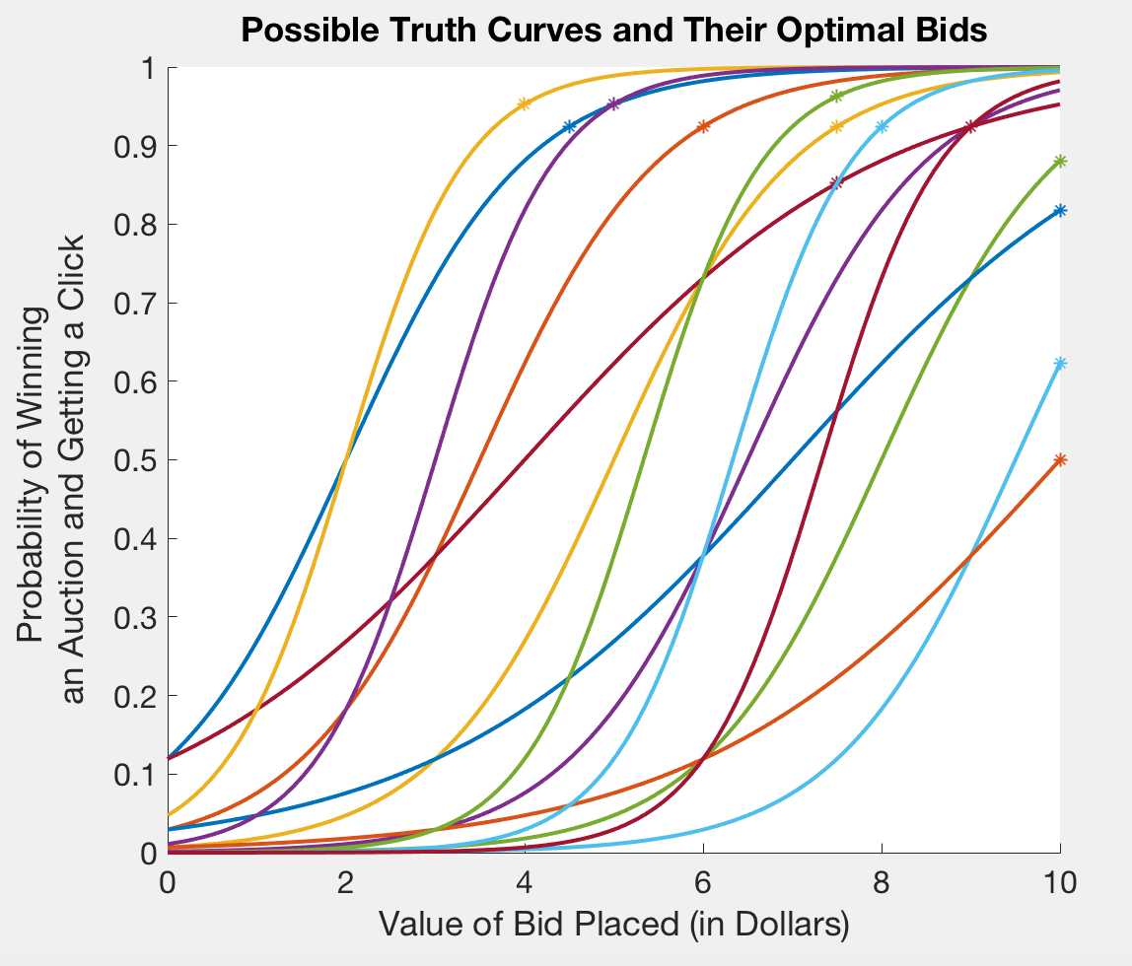
1 & 2: Sampled Belief Model
Discrete set of “M” alternative decisions (bids)
Discrete set of “K” possible truths (probability curves)
At each time step “n,” you have a certain belief, which updates as you place bids and get responses
Your belief is a set of probabilities that each possible truth is the real truth

Slide 4
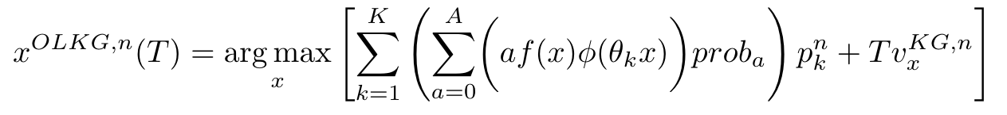
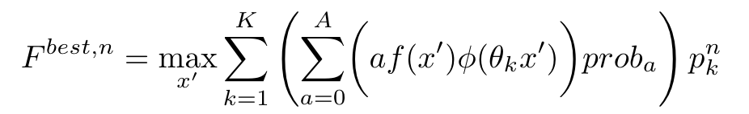
1. Next Step is 1 Hour
The alternative chosen by this policy:
Tunable parameter T, which represents the “time horizon” and decides how much value to place on the value of learning
The offline knowledge gradient for each alternative:
The best expected one-period reward:

Slide 5
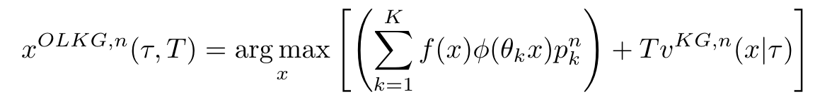
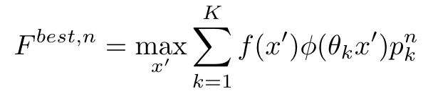
2. Multistep Look-ahead (Next Step is 1 Auction)
The alternative chosen by this policy:
Tunable parameter tau, the number of auctions to look ahead in the offline knowledge gradient calculation
Tunable parameter T, which represents the “time horizon”
The offline knowledge gradient for each alternative:
The best expected one-period reward:

Slide 6
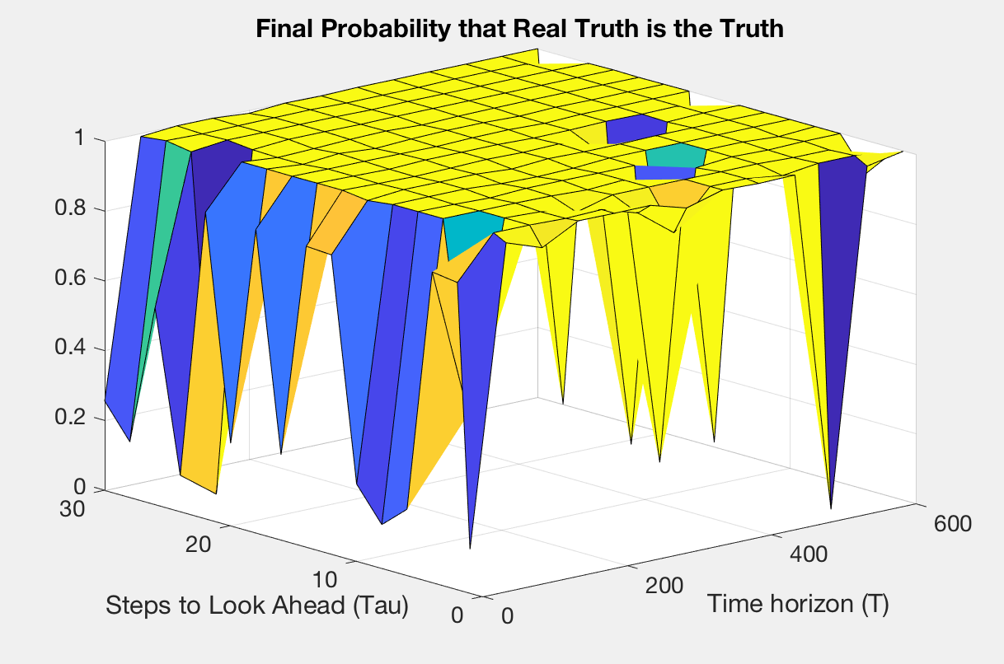
2. Multistep Look-ahead (Next Step is 1 Auction)

Slide 7
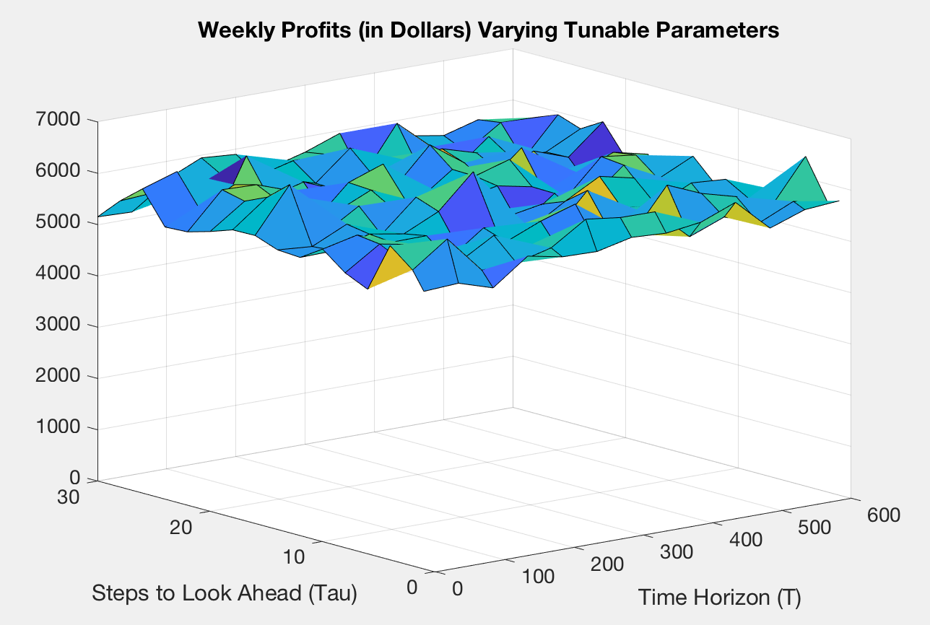
2. Multistep Look-ahead (Next Step is 1 Auction)

Slide 8
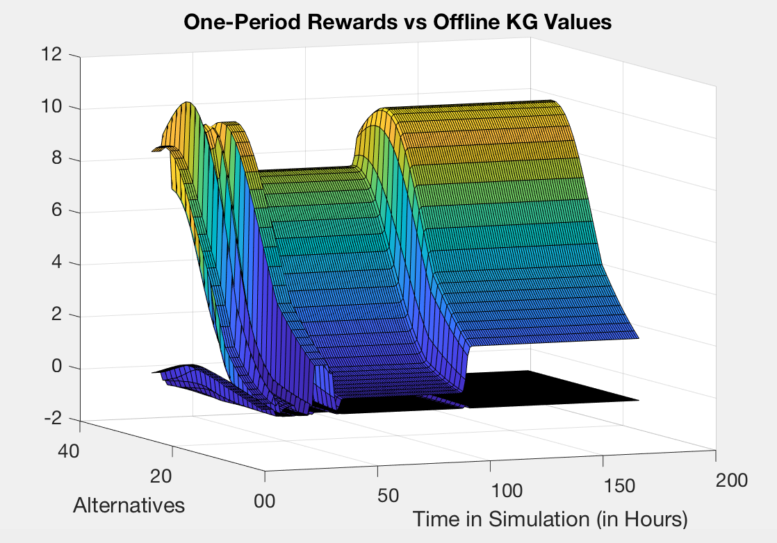
2. Multistep Look-ahead (Next Step is 1 Auction)

Slide 9
2. Complicating the Problem Setting
Randomly changing the truth during the simulation
Fixing the time that the changes occur to get a distinct idea of what happens when the changes occur
Toggling between two classes of very different truths
Having a single truth that is very different than all of the possible truths

Slide 10
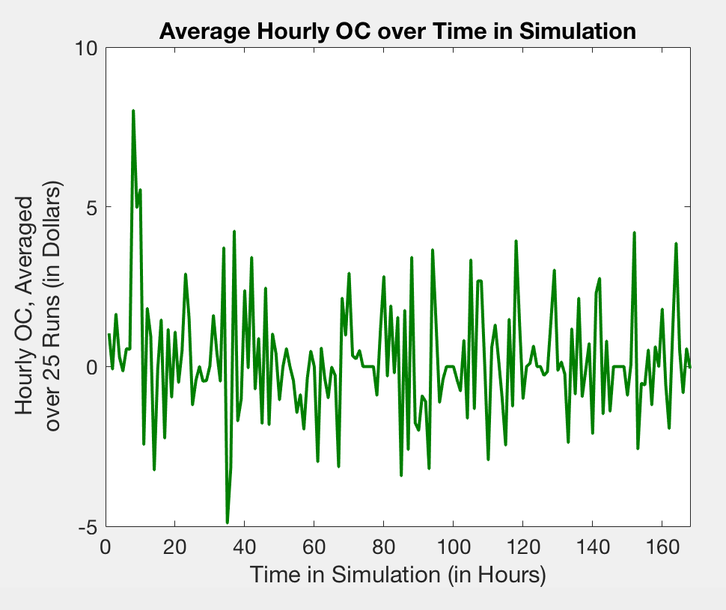
2. Performance over Time in Simulation
Fix values of the tunable parameters
Time horizon = 100
Auctions to look ahead = 5
Opportunity cost: Difference between the profits you would have earned if you knew the truth and the profits you earned using the policy

Slide 11
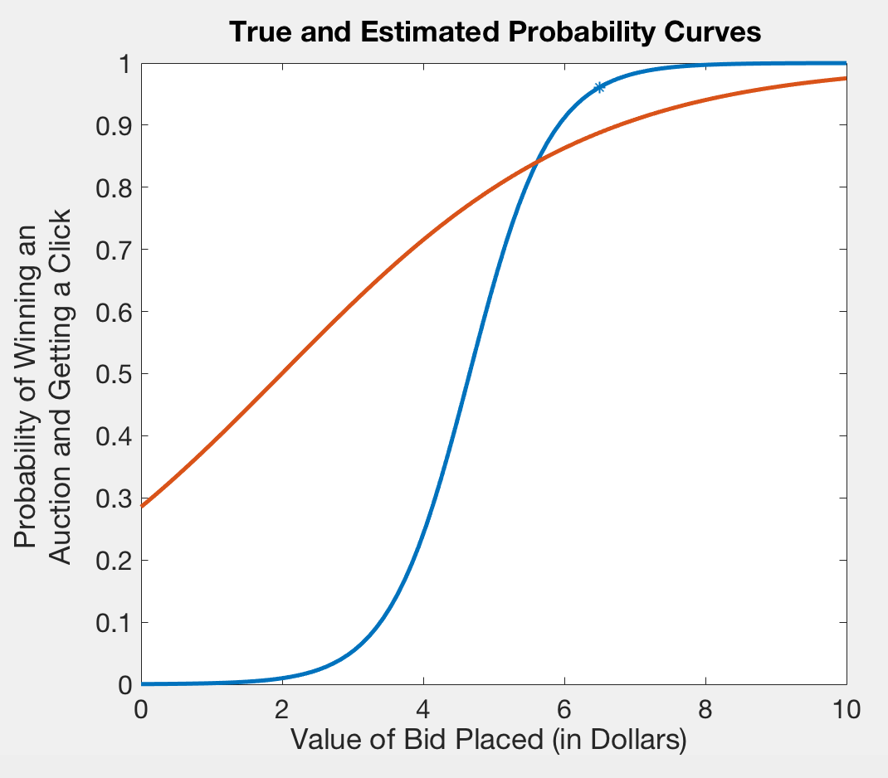
3. Parametric Belief Model
Adapted from Yingfei Wang’s research on KG with binary feedbacks
Discrete set of “M” alternative decisions (bids)
At each time step “n,” the belief is an estimate of the coefficients that determine the curve and respective variances
The policy isn’t concerned with perfecting it’s estimate of the curve, but rather perfecting it in the area of the best alternatives

Slide 12
3. Online Application and the Tunable Parameter
The alternative chosen by this policy:
Tunable parameter T, which represents the “time horizon” and decides how much value to place on the value of learning versus the one-period expected reward

Slide 13
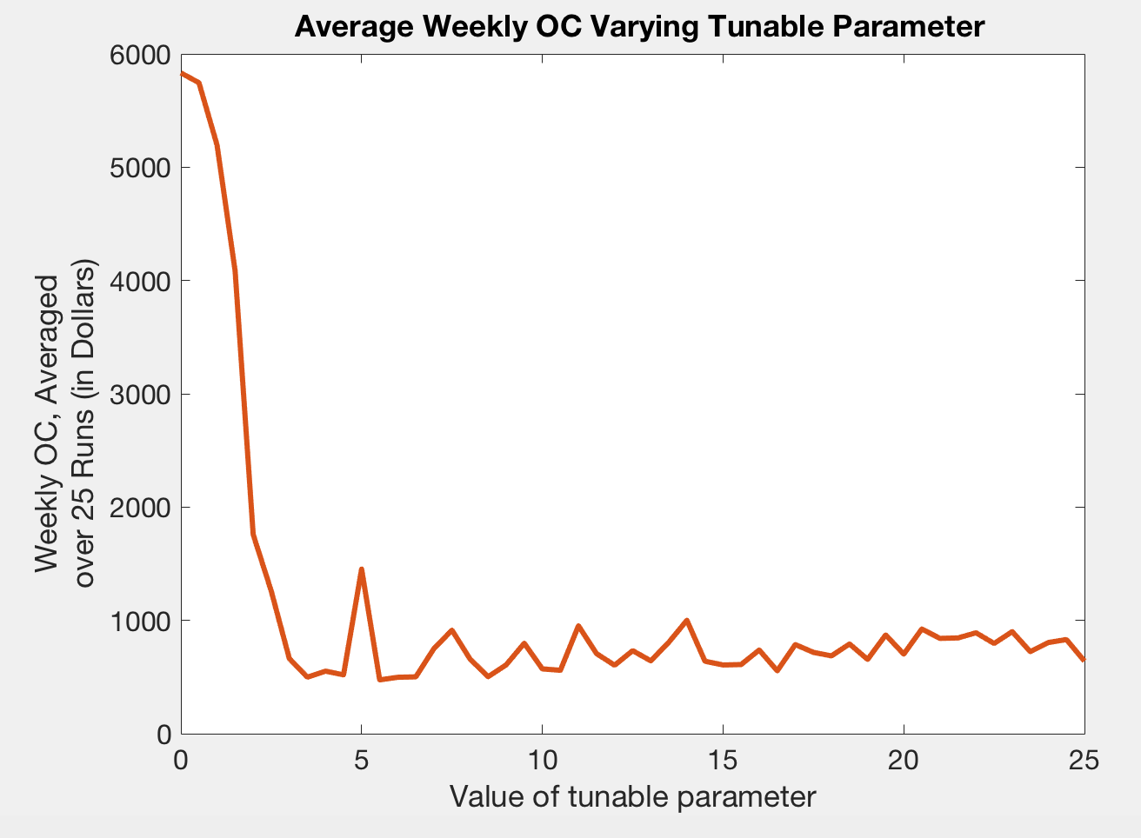
3. Online Application and the Tunable Parameter
Simplest problem setting
No attributes in play
Set 1 fixed truth (a true probability-of-click function) at the start of each week
Opportunity cost: Difference between the profits you would have earned if you knew the truth and the profits you earned using the policy

Slide 14
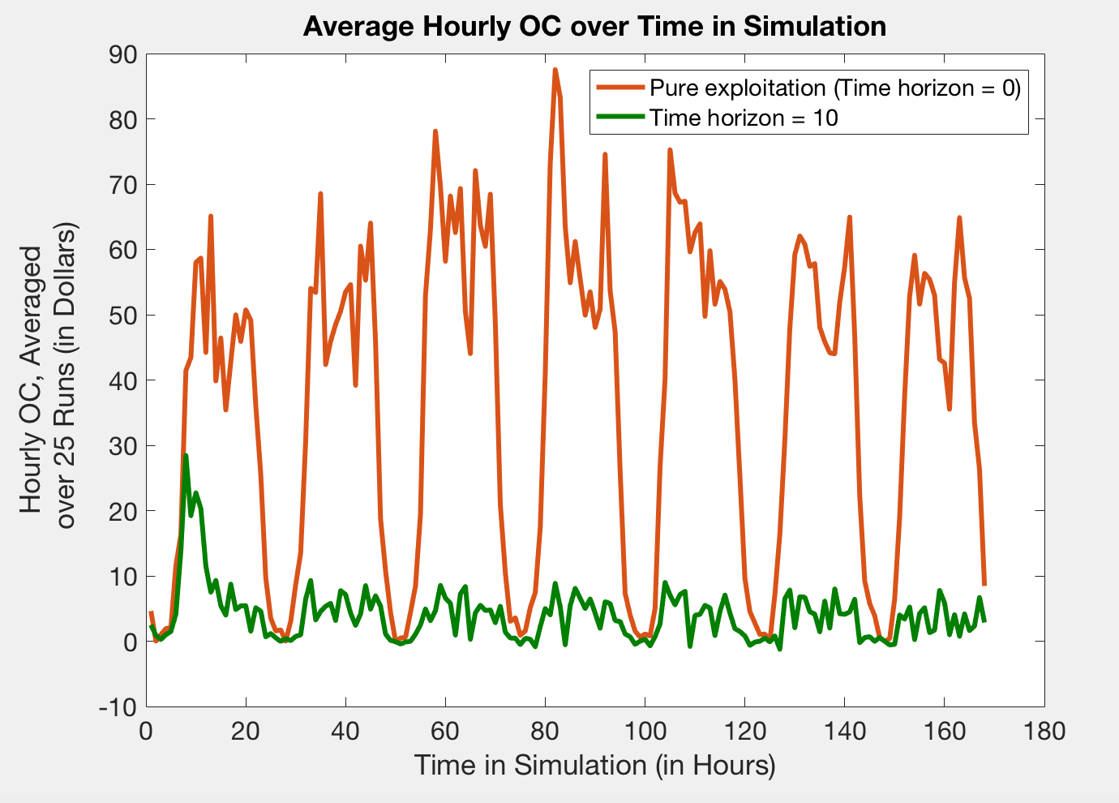
3. Performance Over Time in Simulation
Simplest problem setting
No attributes in play
Set 1 fixed truth (a true probability-of-click function) at the start of each week
Opportunity cost: Difference between the profits you would have earned if you knew the truth and the profits you earned using the policy
Value of tunable parameter = 10 vs pure exploitation

Slide 15
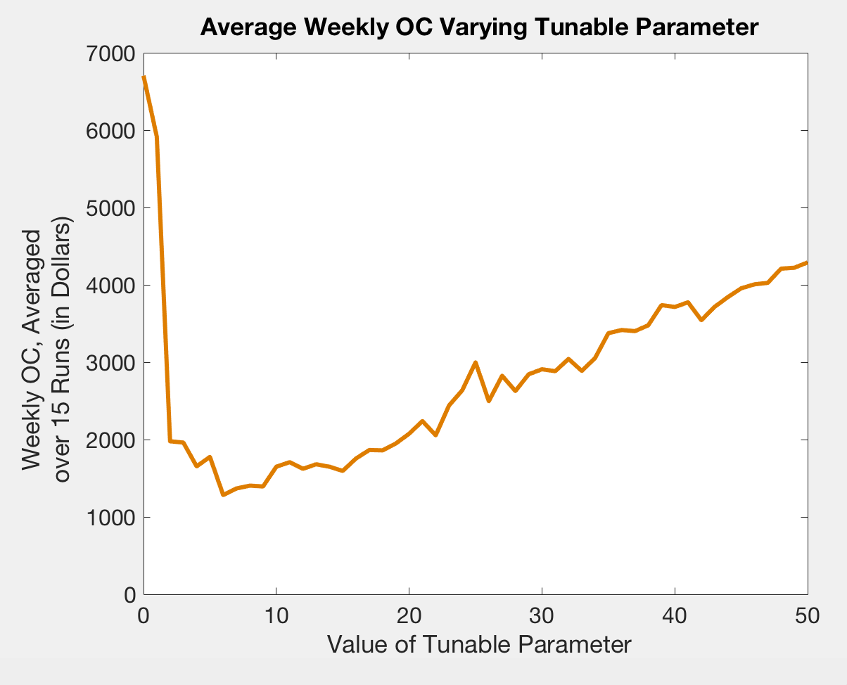
3. Incorporating (Location) Attributes
Complicates problem setting
Each auction comes from a specified city (and country and region)
Set 1 fixed truth (a true probability-of-click function) at the start of each week
Simple fix: Add terms to probability function

Slide 16
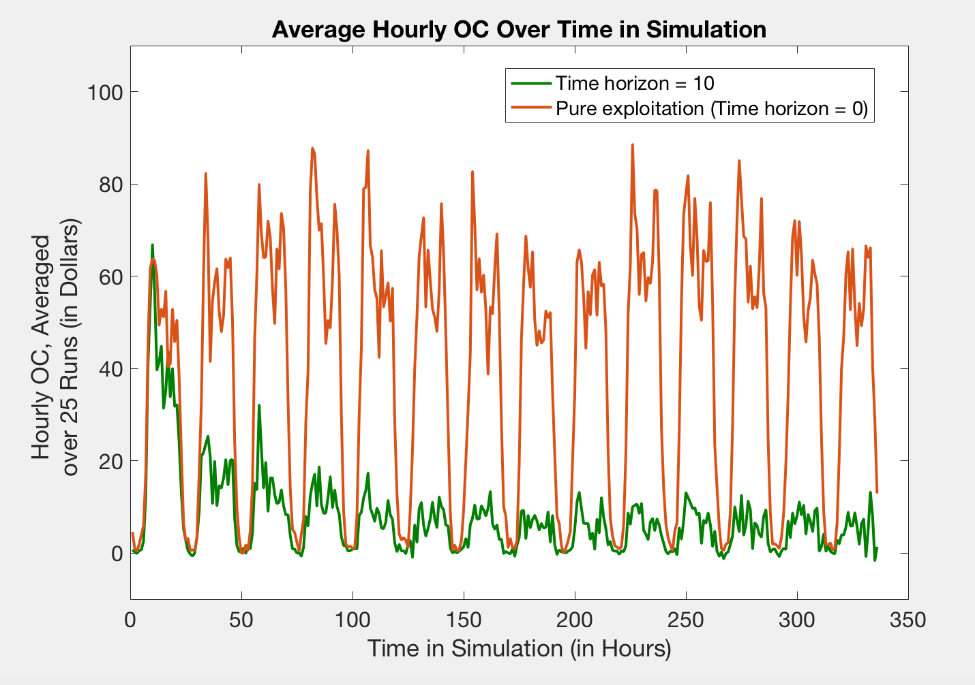
3. Performance over Time in Simulation
Complicates problem setting
Each auction comes from a specified city (and country and region)
Set 1 fixed truth (a true probability-of-click function) at the start of each week
Simple fix: Add terms to probability function
Value of tunable parameter = 10 vs pure exploitation

Slide 17
Conclusion
Policy 2 (Multi-step look-ahead using sampled belief model)
Performs very well in simple problem setting
Policy 3 (Adapted from Yingfei Wang’s research using parametric belief model)
Efficient enough to handle high-dimensional attributes
Next steps
More rigorous simulation, possible with noisier data sets

